Slide 1
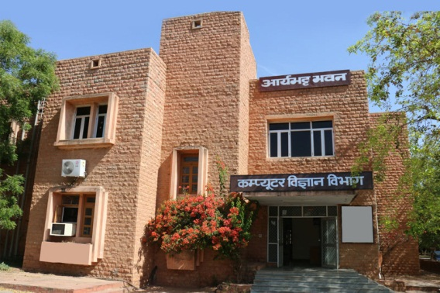
Dept. of Computer Science

Slide 2
About Department
Established in the year 1994
Vision of the Department to impart quality post graduate education
Carry out leading-edge research in the field of Computer Science and Information Technology
The department commenced with PGDCA course, then M. Sc. In Computer Science,
Presently, the department runs 4 major technology based courses
  Ph.D (Computer Science)
  M. Tech Computer Science
  MCA
  BCA (Hons)
Engaged in research work in Spatial Database Management Systems, Biometrics & Ad-hoc Networking, BIGDATA, Machine Learning, Image Processing.
Well equipped laboratories with state-of-the-art computing facilities to support the research and teaching activities for open source, Object Oriented DBMS, Grid computing, BIGDATA, GIS, image processing, MATLAB, NS2

Slide 3
Vision Statement
To provide the utmost favourable environment for quality focused education.
To provide research-oriented learning in undergraduate and postgraduate education in computer science and engineering.
To prepare the students for becoming quality professionals holding important positions in the IT industry in India and abroad.
Create computer professionals for the globalised technological society and orient them towards serving the society

Slide 4
Courses
  Ph.D (Computer Science)
  M. Tech Computer Science
  MCA
  BCA (Hons)

Slide 5
Course – BCA (Hons)
BCA (Hons) – Bachelor in Computer Applications
BCA (Hons) programme commenced in 2020
20 students per year intake
Under-graduate programme in Computer Applications
Aims to provide strong technical skill set and domain knowledge to develop application programs.
Teaching & learning methodologies:
  Assignments, Tutorials, Classroom teaching, guest lectures, case studies, seminars, conferences, laboratory works, quizzes, industry projects and presentations.

Slide 6
Course - MCA
MCA (Masters of Computer Applications
MCA programme commenced in 2009
20 students per year intake
Post graduate programme in Computer Applications
Aims to provide strong technical skill set and domain knowledge to develop application programs.
Teaching & learning methodologies:
  Assignments, Tutorials, Classroom teaching, guest lectures, case studies, seminars, conferences, laboratory works, quizzes, industry projects and presentations.
  Specialization provided in Artificial Intelligence, GIS, Image Processing, BIGDATA, Data Mining, Ad hoc Networks

Slide 7
Course – M. Tech Computer Science
M. Tech (Computer Science)
M. Tech (Computer Science) programme was commenced in 2014
18 students per year intake
2 years Post graduate programme in Computer Science, Engineering & Technology
Developing experts and professionals in Computer Science is the objective of the course
Aims to provide strong technical skill set and domain knowledge that are able to match the demands of the industry standards with technical and managerial abilities
Teaching & learning methodologies:
  Classroom teaching with detailed course, assignments, Tutorials, visiting lectures, seminars, conferences, laboratory works, industry projects and presentations.
  Specialization provided in Machine Learning, Advance Computer Graphics, Mobile Computing and Apps Development, Artificial Intelligence, GIS, Image Processing, BIGDATA, Data Mining, Ad hoc Networks, Information Security

Slide 8
Course – Research
Research
Ph. D. in Computer Science
Empowering research scholars to become
  part of the global research ecosystem,
  contribute to research organizations,
  and top class universities across the world
The program is based on the best practice models at top universities like University of Waikato, Griffith University
Teaching & learning methodologies:
  Assignments, Tutorials, visiting lectures, seminars, conferences, laboratory works, industry projects and presentations.
  Specialization provided in Machine Learning, Advance Computer Graphics, Spatial Database and Spatial Data Mining, Image Processing, BIGDATA, Data Mining

Slide 9
Projects
Developed Industry based projects:
Land Information System for Ajmer using GIS
Higher Education GIS
Smart City GIS
E-Learning for C, C++, Java language
E-Learning for Computer Architecture, Computer Graphics, DBMS
Web-based Store Management System, Attendance System, Library Management System
Apps developed for Higher Education
Data mining for large data sets

Slide 10
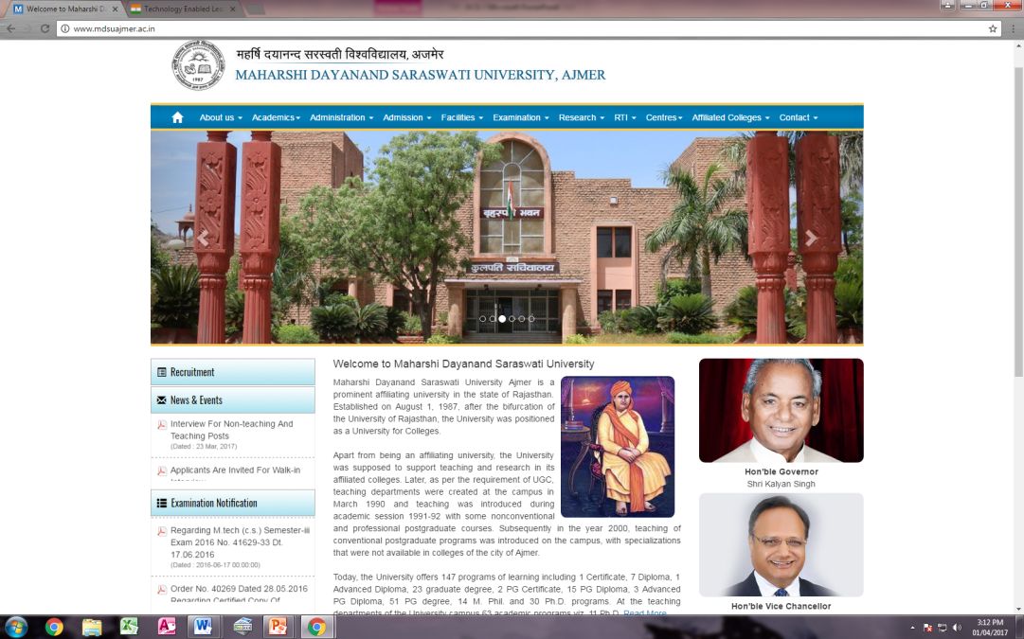
Website
www.mdsuajmer.ac.in
The University Official Website was designed and deployed by the department.
Dynamic and implements Boot Technology
Device Friendly design
Official email facility provided

Slide 11

National Mission on Education through Information and Communication Technology (NMEICT)
MHRD Sponsored Scheme to enhance the potential of ICT, in teaching and learning process
The Scheme benefits all the faculty, students, researchers in Higher Education Institutions in any time any where mode
Department played a nodal role in designing and implementing the campus wide network under this project of MHRD, Govt. of India
NMEICT project involves Wi-Fi in the campus wide networking

Slide 12
Faculties
Core Faculty | Qualification
Prof. Neeraj Bhargava | Ph. D. Computer Science, MS Computer Science, B. Tech Comp Sci & Engg.
Papers published:
International Journals | 80
National Journals | 10
Conferences:
International | 25
National | 90
Books:
International Publications | 2
National Publications | 16

Slide 13
Faculties
Guest Faculties
Sh. Vaibhav Khanna | MCA, NET
Dr. Praful Narooka | Ph. D. Computer Science
Sh. Pramod Singh Rathore | M. Tech (Computer Science & Engineering)
Sh. Kapil Chouhan | M. Tech (Computer Science & Engineering)
Sh. Vishal Dutt | MCA
Smt. Kusumlata Gehlot | M. Tech (Computer Science)
Smt. Chandra Prabha Agrawal | M. Tech (Computer Science & Engineering)

Slide 14
What we have done for Society?
Designing - Delivering Computer Education
Spreading Digital Awareness to Rural Rajasthan
Spread the reach of New Technologies

Slide 15
What we have done for Society?
Designing – Delivering Computer Education
Designed several courses for computer education at various levels from UG to PG
Provide career oriented training for a specific career requirements – MCA , M. Tech
Provide a "state of the art" environment for research and scholarly activities
Contributing to the cause of knowledge based society

Slide 16
What have we done for Society?
Spreading Digital Awareness
Creating a digitally empowered society
Enabling social change by technology centric learning and usage.
Spreading awareness of E-Governance initiatives.
Conducting conference and seminars on safe and secure use of cyber space

Slide 17
What have we done for Society?
Spread the reach of New Technologies
Conferences in several colleges in rural and semi urban areas on new and up coming technologies
Development of mobile apps for promoting higher education

Slide 18
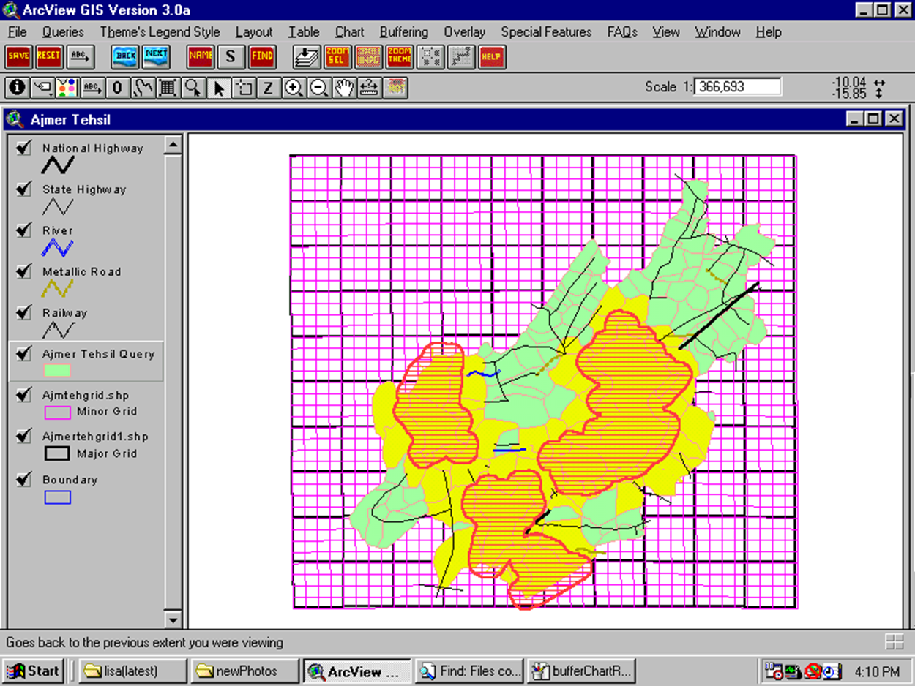
Geographical Information Systems
Rajasthan Map
Query
Overlay
Union

Slide 19
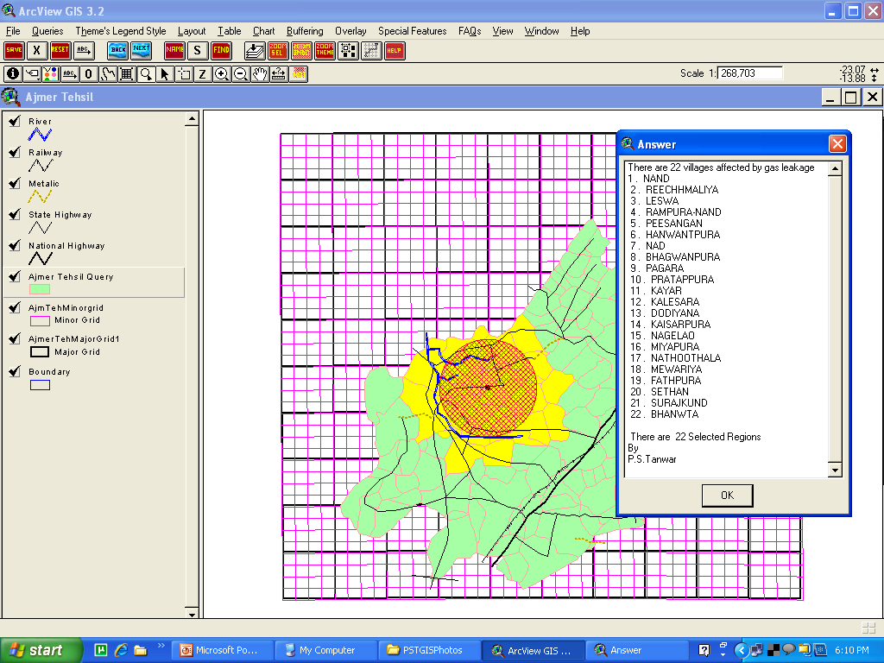
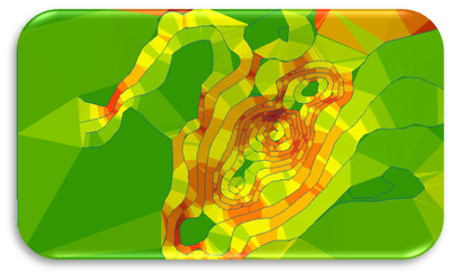
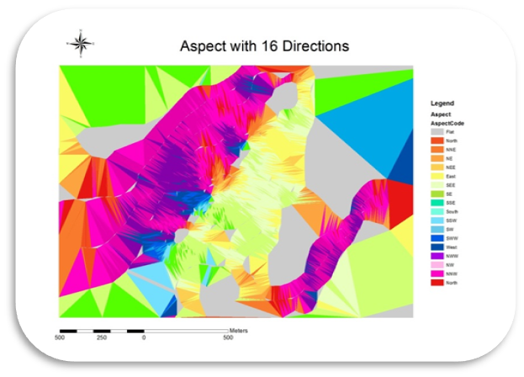

Advance Computer Graphics
Buffering
TIN Model
Interpolation
Aspect Analysis
Hill Shade Analysis
Slope Analysis

Slide 20
Future Facility:
Center for Big Data Analytics and Data Science
Data Analytics and Data Science professional is one of the most highly paid jobs in India and abroad.
This makes Data Science a highly lucrative career option.
We envision, as a near future facility, a center for Big Data Analytics and Data Science with a team that focuses the vision, strategy, and infrastructure for a data science discipline.
This is particularly useful for data science because of the niche skills and technology the discipline requires.

Slide 21
Engineering Courses
B. Tech (Computer Science)
B. Tech (Information Technology)
M. Tech (Artificial Intelligence)
M. Tech (Data Science)

